Slide 1
VSD-BGR-DESIGN WORKSHOP-LABS
NARESH KUMAR G

Slide 2
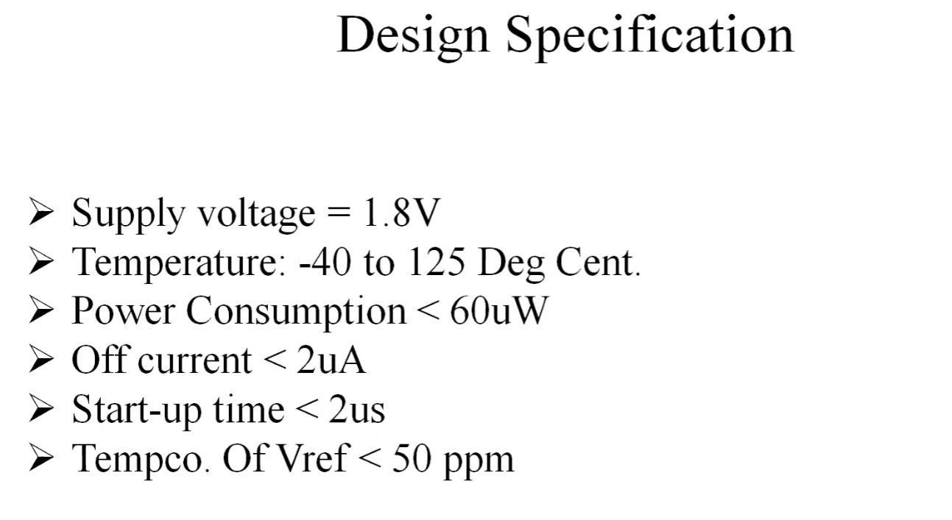

Slide 3
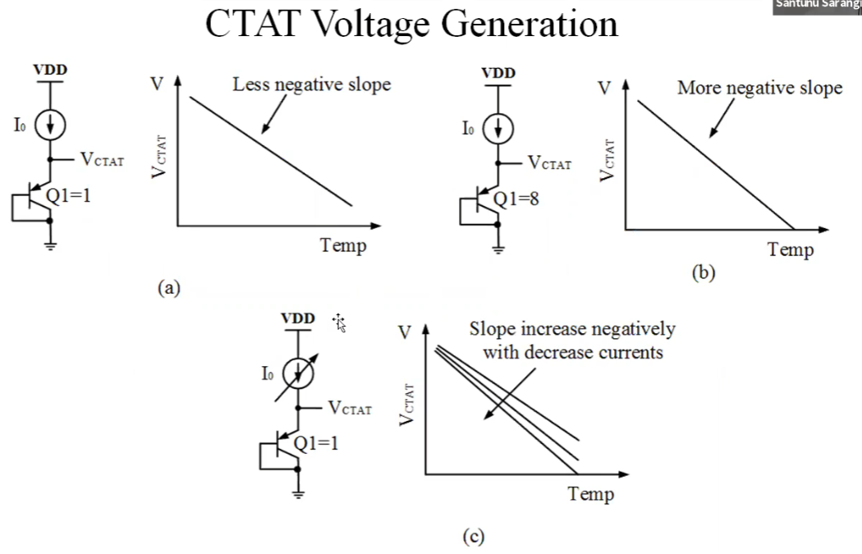
CTAT SIMULATION:

Slide 4
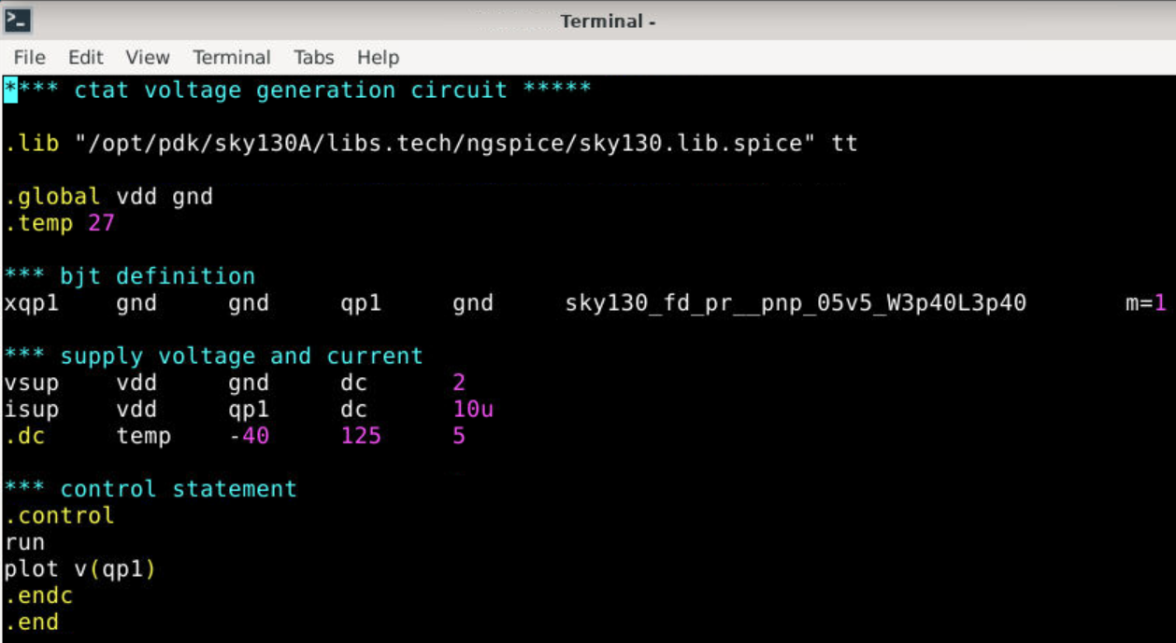
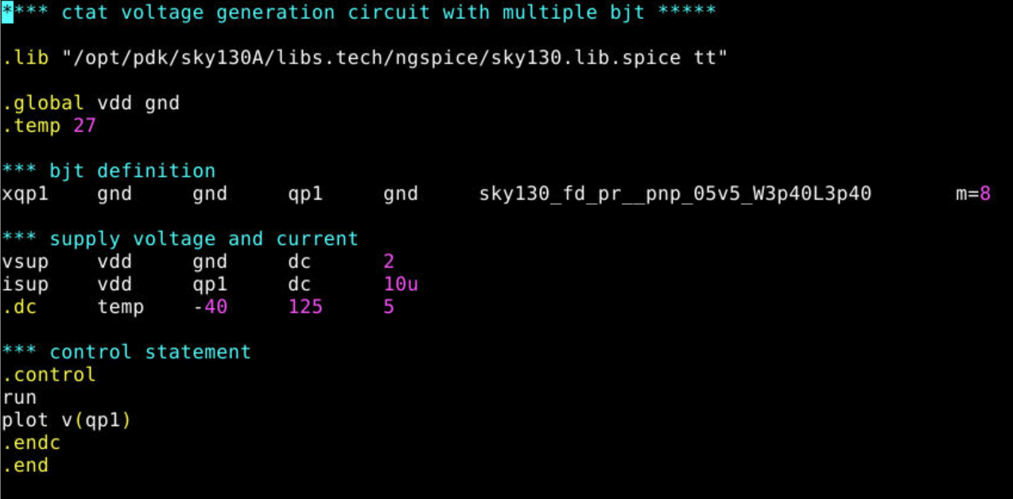
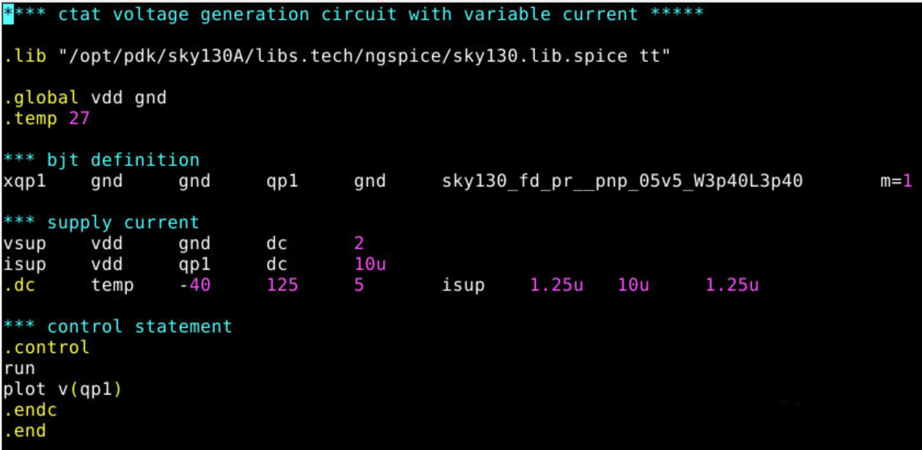
CTAT SIMULATION netlist:

Slide 5
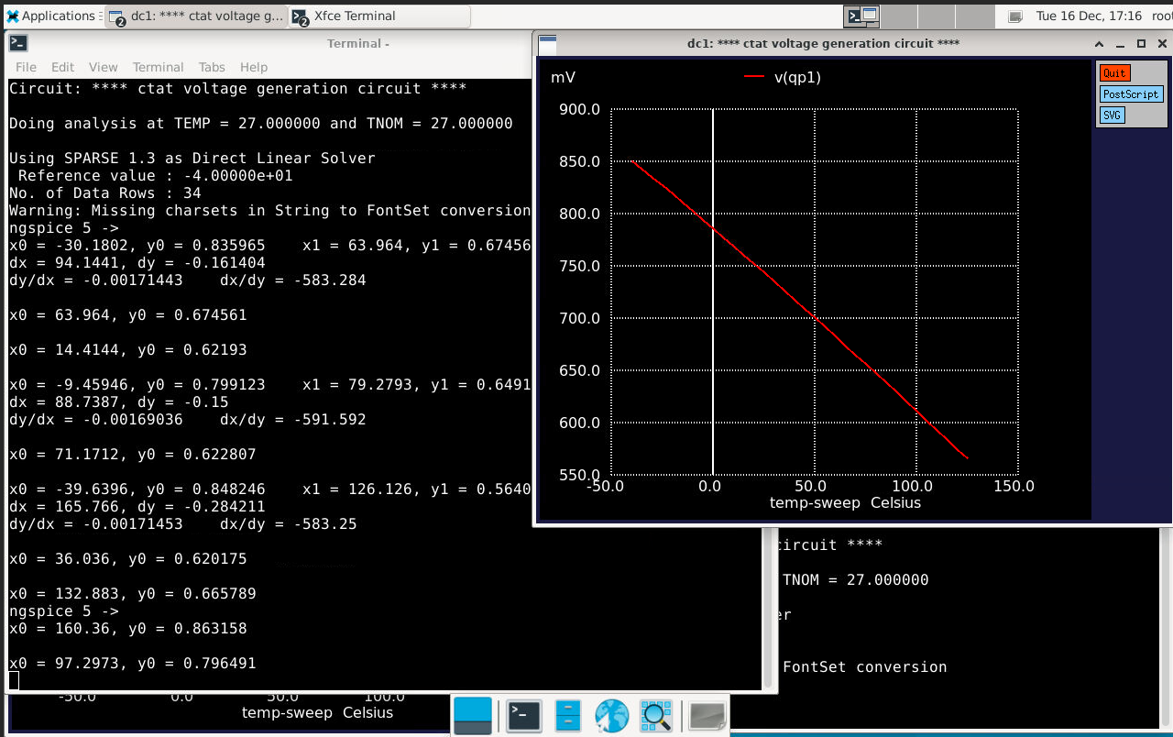
CTAT SIMULATION:

Slide 6
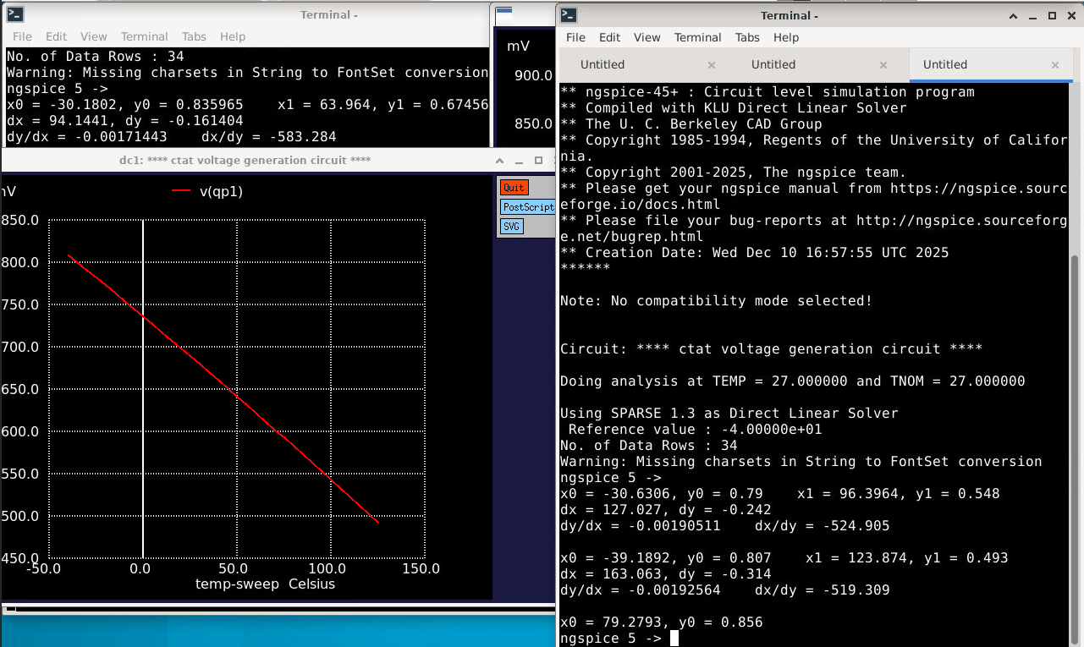
CTAT SIMULATION with N=8 bjt:

Slide 7
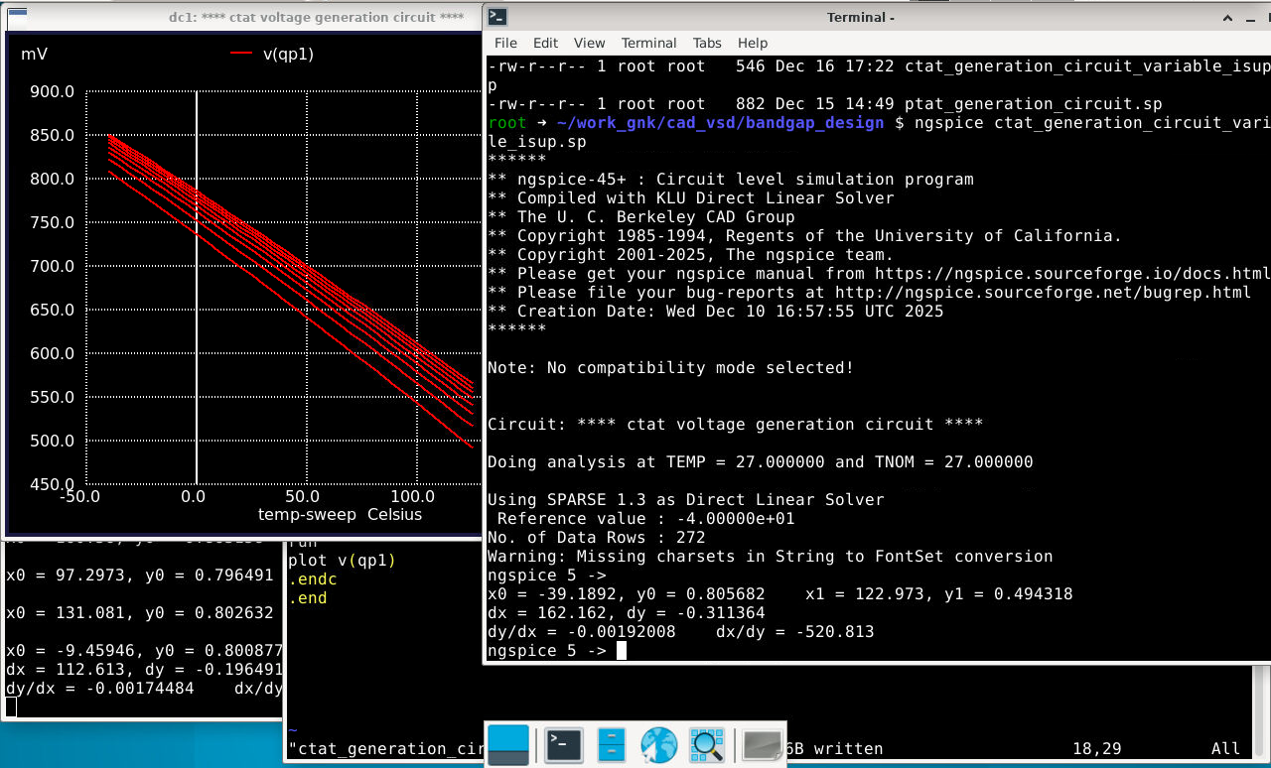
CTAT SIMULATION with variable supply:

Slide 8
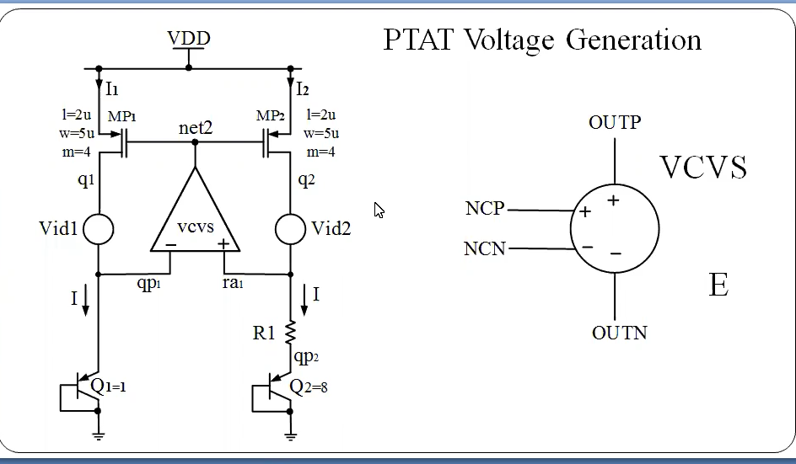
PTAT SIMULATION:

Slide 9
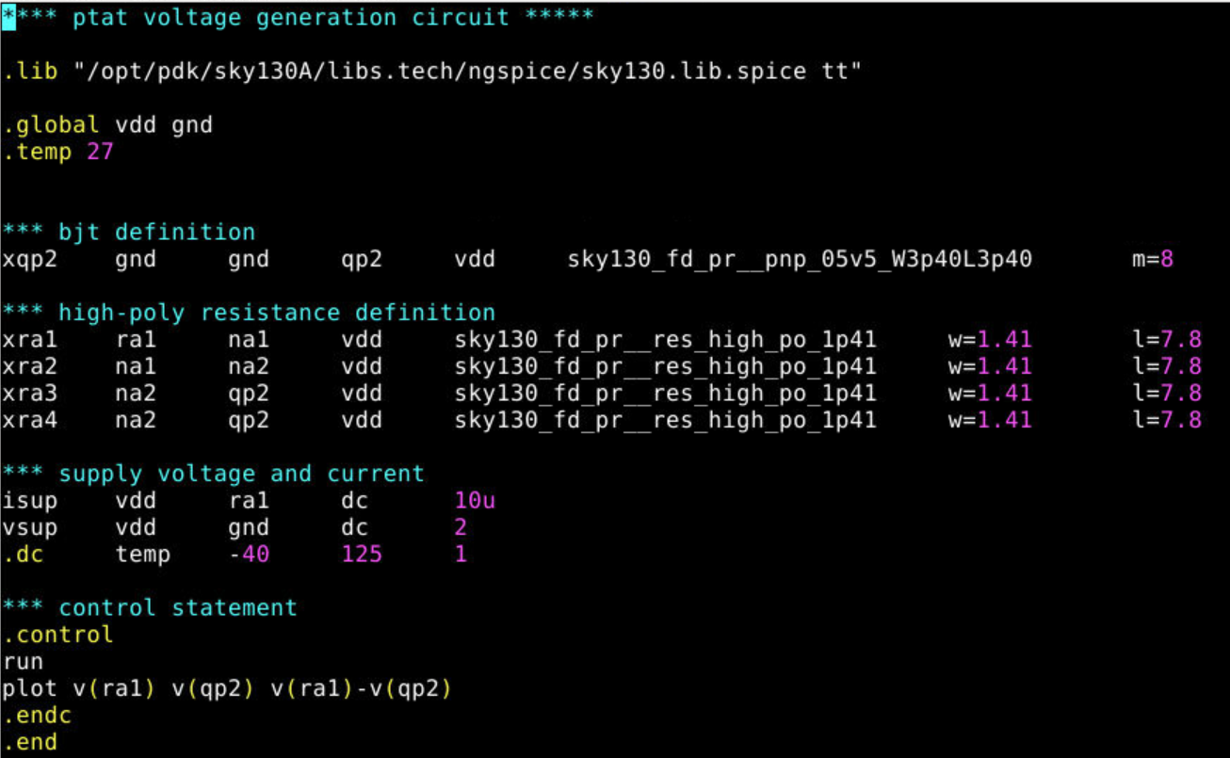
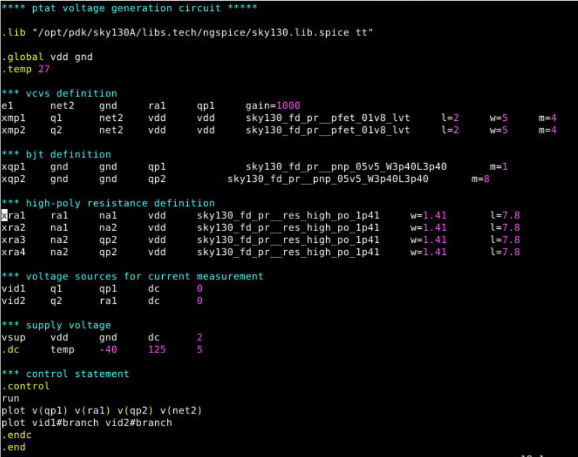
PTAT SIMULATION netlist:
Ptat_generation netlist with ideal current source
Ptat_generation netlist with vcvs

Slide 10
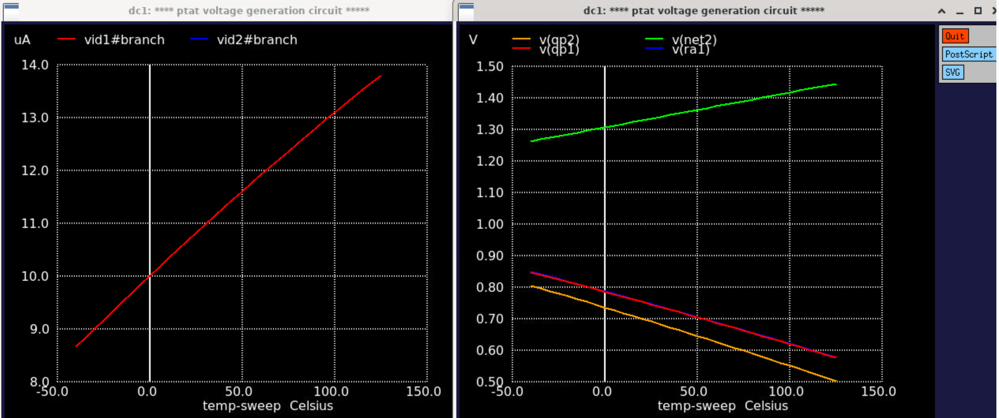
PTAT SIMULATION:

Slide 11
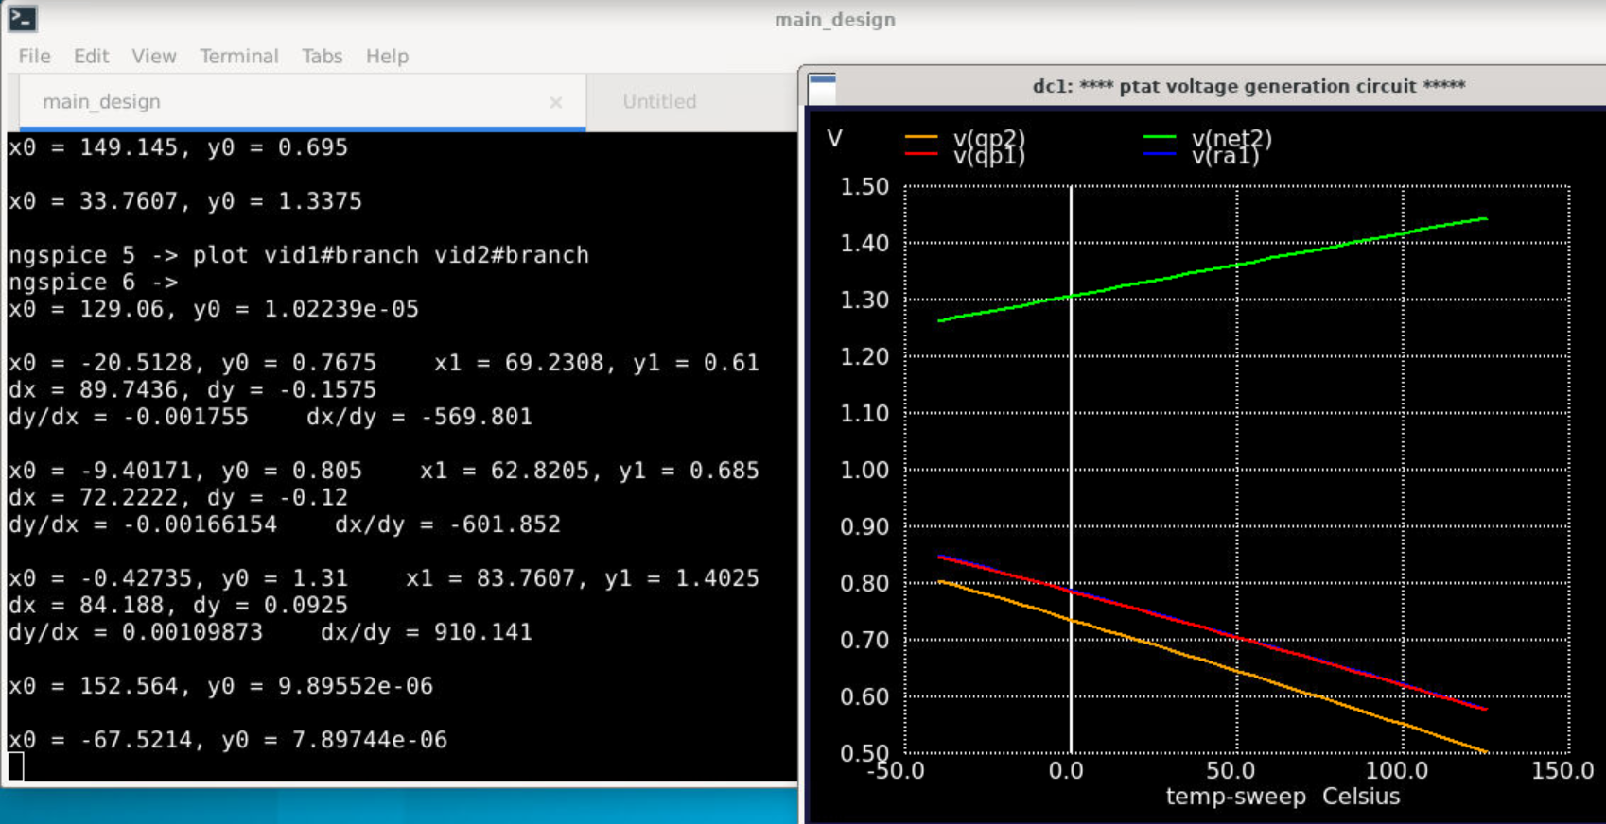
PTAT SIMULATION:

Slide 12
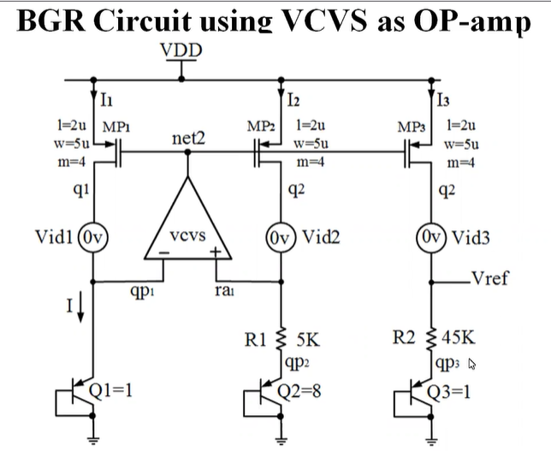
COMPLETE BGR SIMULATION

Slide 13
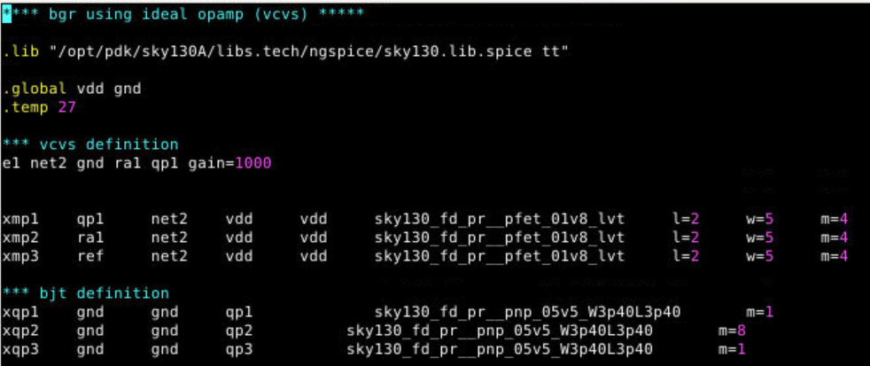
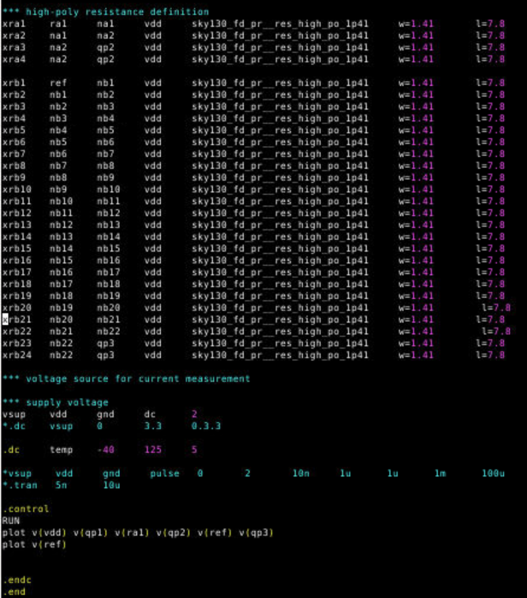
COMPLETE BGR SIMULATION

Slide 14
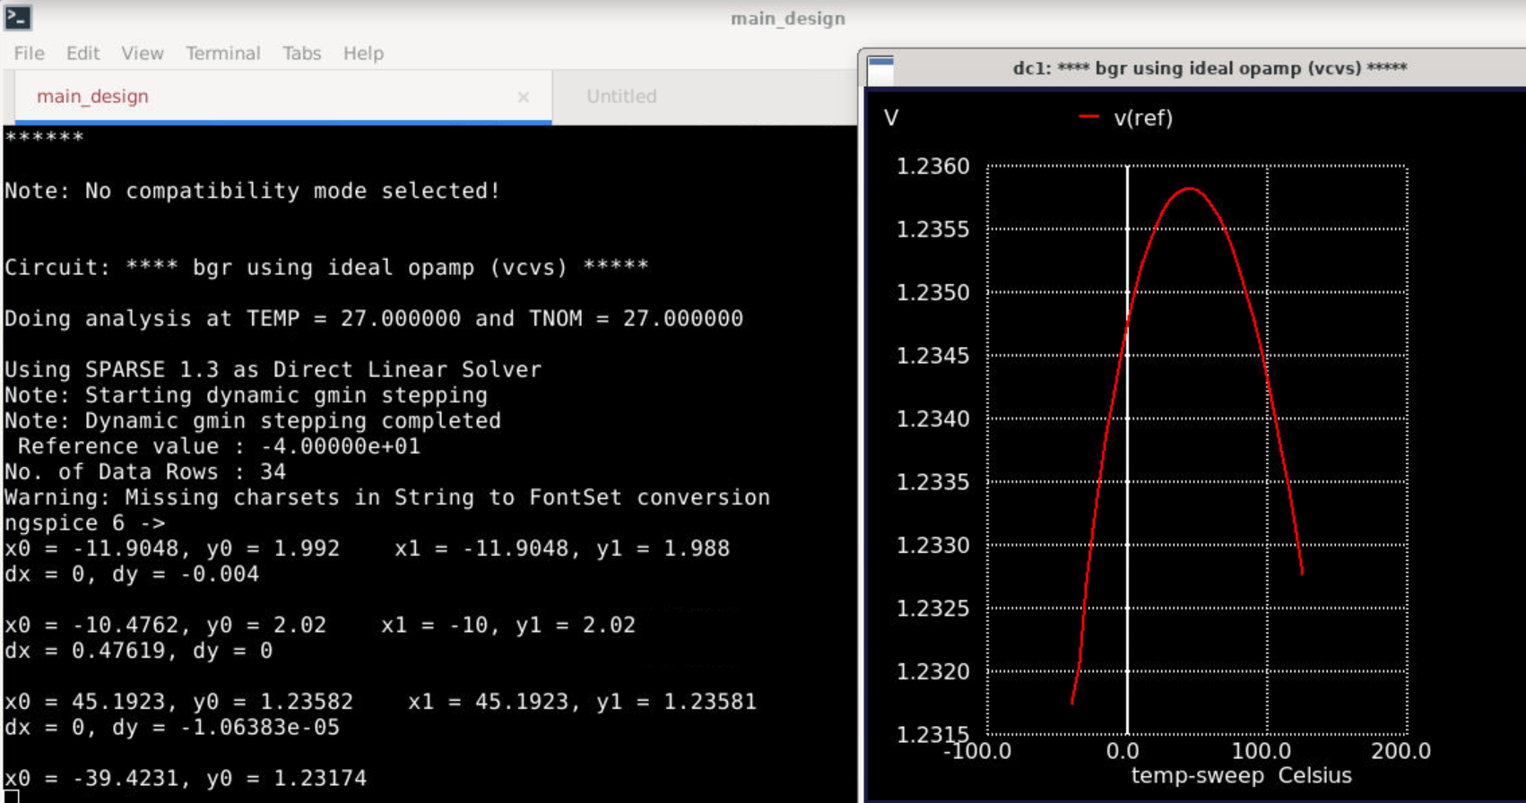
COMPLETE BGR SIMULATION
With temperature drift of 20.8 ppm/degC

Slide 15
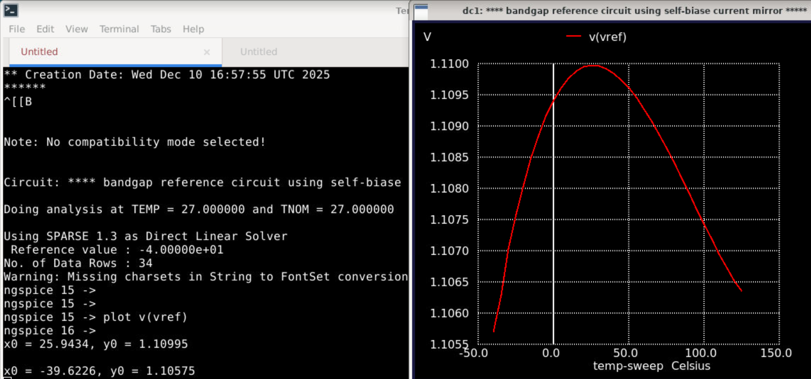
COMPLETE BGR SIMULATION
Results With Self Bias Current Mirror
With temperature drift of 21.21 ppm/degC

Slide 16
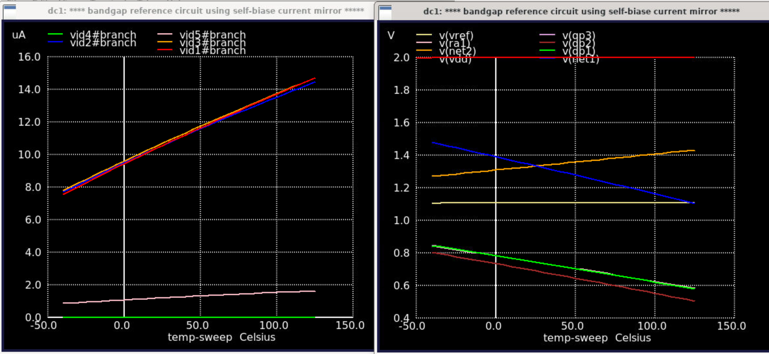
COMPLETE BGR SIMULATION
Results With Self Bias Current Mirror

Slide 17
COMPLETE BGR SIMULATION
Results With Self Bias Current Mirror

Slide 18
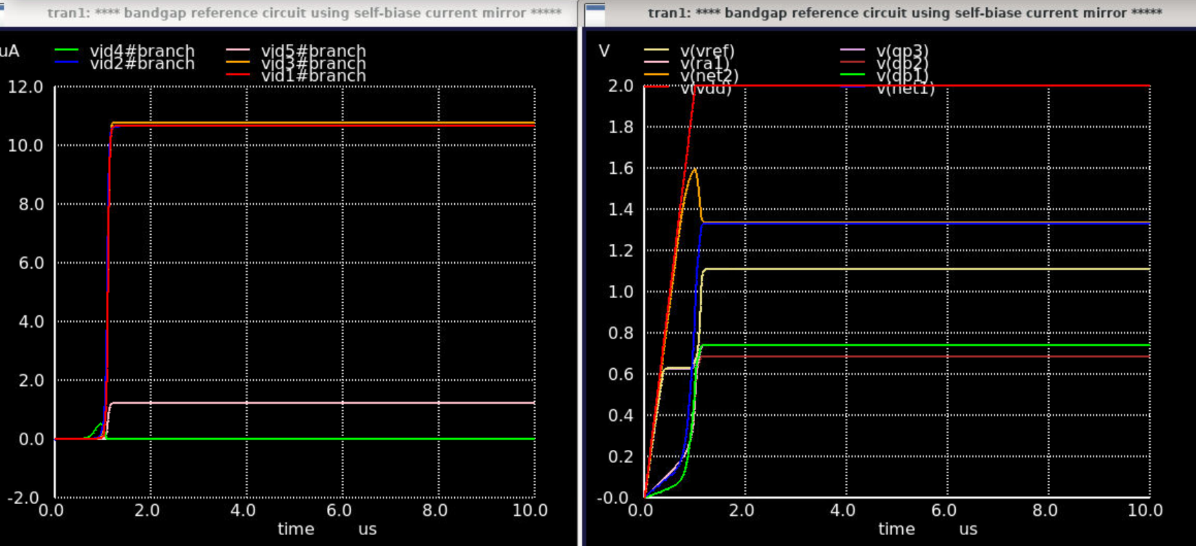
COMPLETE BGR SIMULATION
Results With Self Bias Current Mirror
With startup time less than 2uS

Slide 19
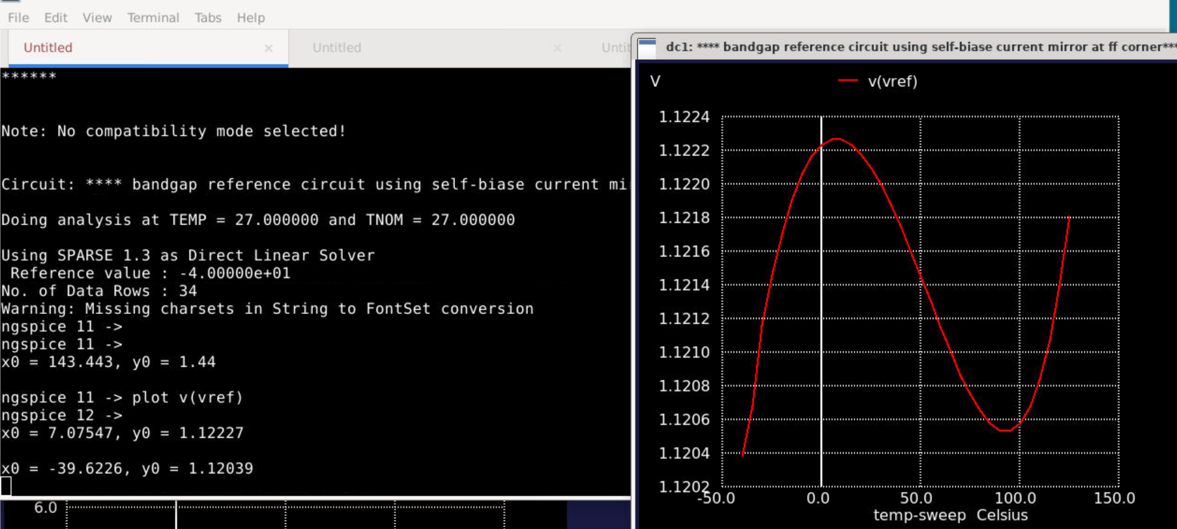
COMPLETE BGR SIMULATION
Results With Self Bias Current Mirror ff corner
With temperature drift of 9.5 ppm/degC

Slide 20
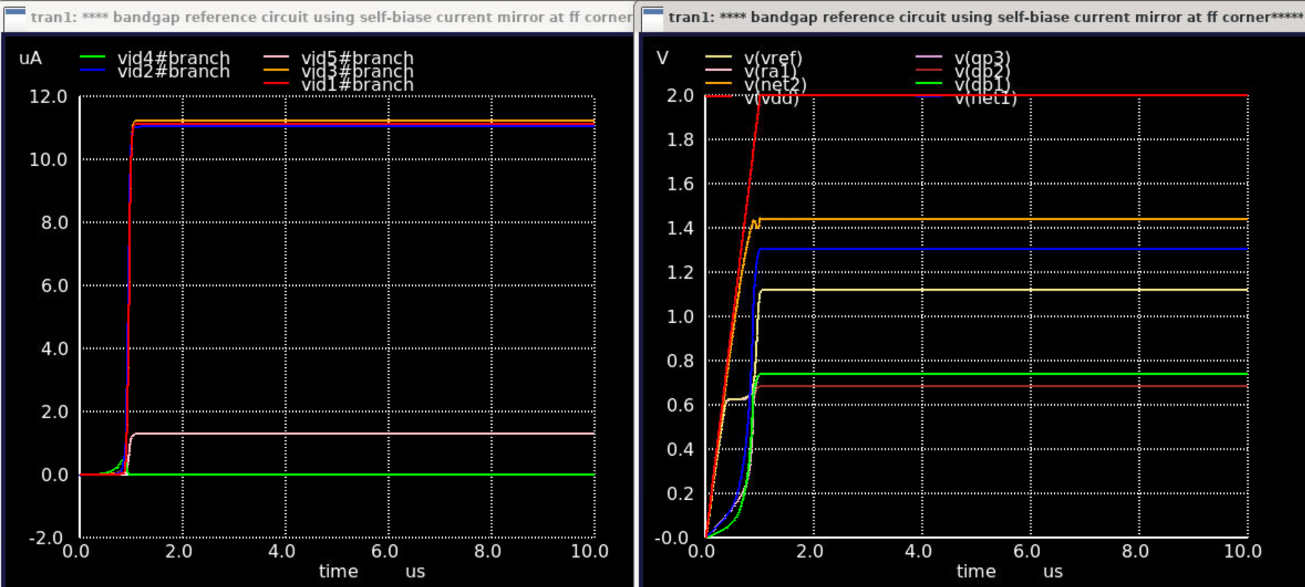
COMPLETE BGR SIMULATION
Results With Self Bias Current Mirror ff corner
With startup time less than 2uS

Slide 21
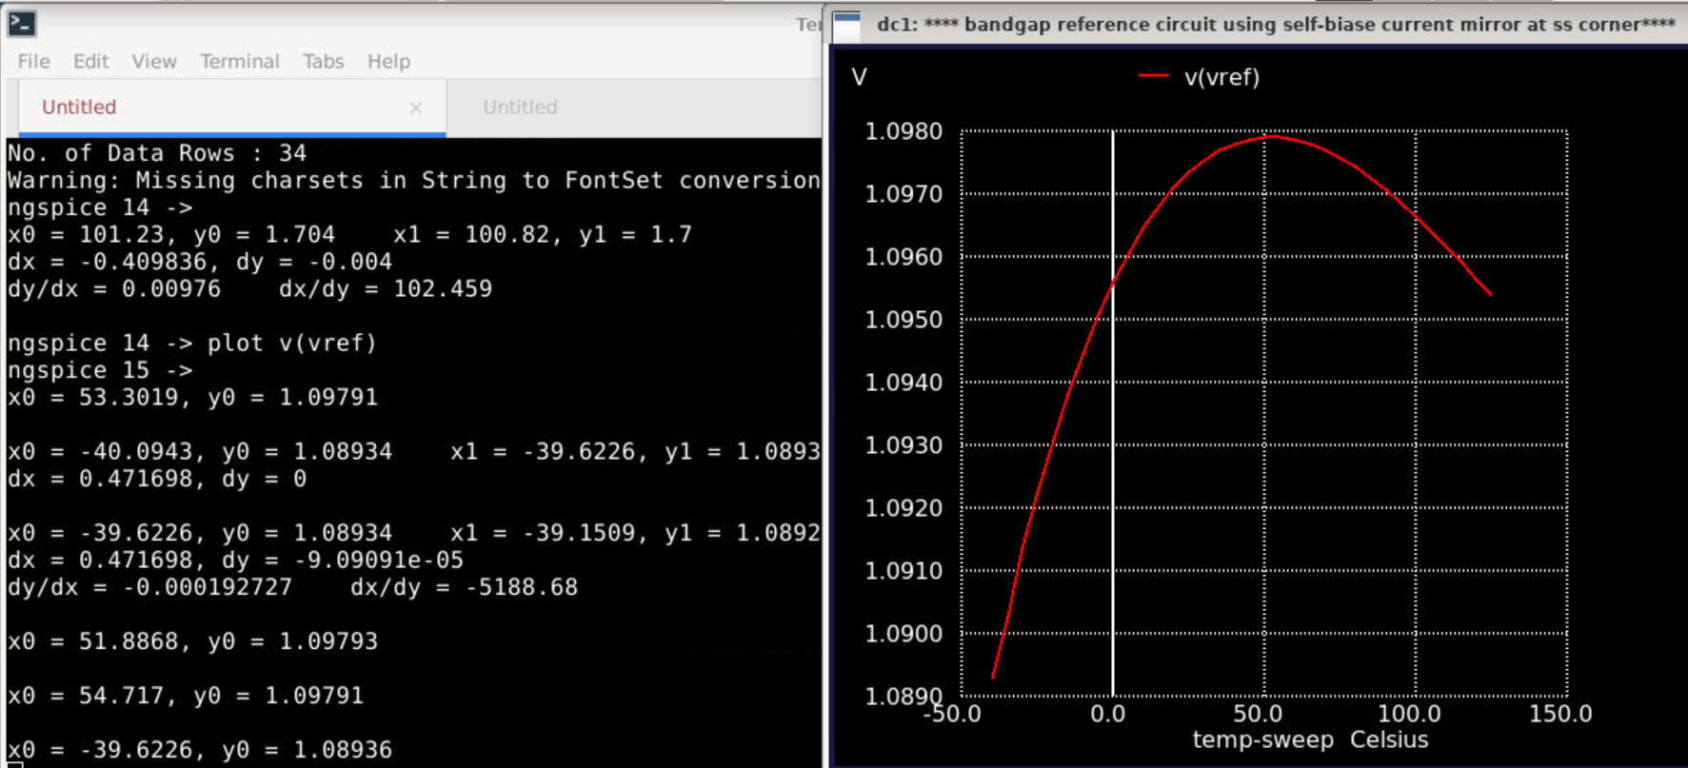
COMPLETE BGR SIMULATION
Results With Self Bias Current Mirror ss corner
With temperature drift of 43.18 ppm/degC

Slide 22
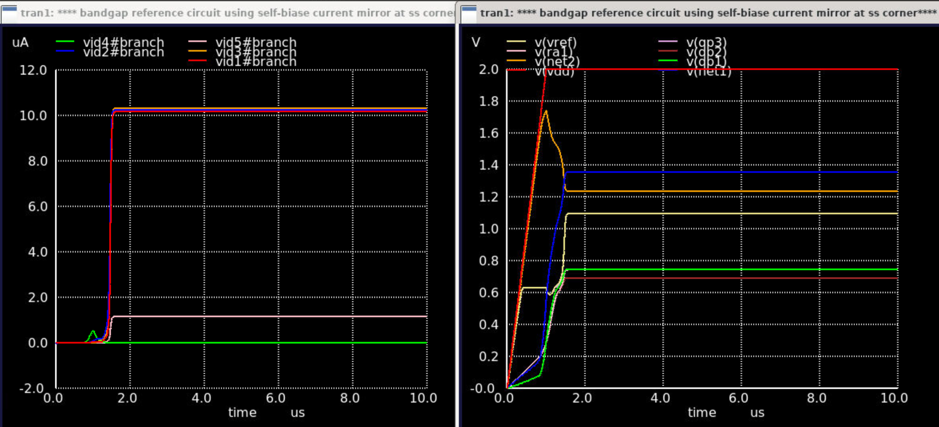
COMPLETE BGR SIMULATION
Results With Self Bias Current Mirror ss corner
With startup time less than 2us

